Slide 1

House pricing Model
Vandana Jain
Internship 10

Slide 2
• Business Problem Framing
Houses are one of the necessary need of each and every person around the globe and therefore housing and real estate market is one of the markets which is one of the major contributors in the world’s economy. Our problem is related to one such housing company. The company uses data analytics to purchase houses at a price below their actual values and flip them at a higher price. For this company wants to know:
• Which variables are important to predict the price of variable?
• How do these variables describe the price of the house?

Slide 3
Data preprocessing
Data preprocessing is the process of cleaning our data set. There might be missing values or outliers in the dataset. These can be handled by data cleaning. If there are many missing values in a variable we will drop those values or substitute it with the average value.
Handling null values
Understanding the data through univariate an bivariate analysis.
Handling outliers and skeweness.
Analysis statistical values.
Finding features (dependent and independent).
Finding relations.

Slide 4
Influencing factors for house prices are the following:
Area of House
How old is the house
Location of the house
How close/far is the market
Connectivity of house location with transport
How many floors does the house have
What material is used in the construction
Water /Electricity availability
Play area / parks for kids (if any)
If terrace is available
If car parking is available
If security is available

Slide 5
Methods using for modeling:
K Neighbors Regressor
Support Vector Regression
Linear Regression
Lasso Regression
Ridge Regression
Decision Tree Regressor
Random Forest Regressor
AdaBoost Regressor
Gradient Boosting Regressor

Slide 6

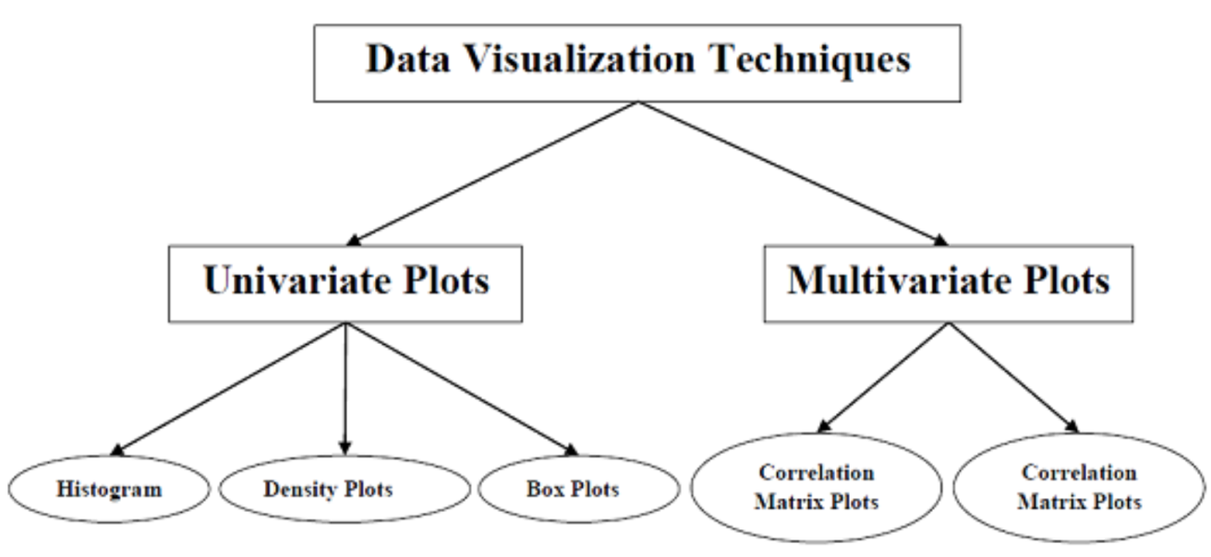
Visualization
Visualisation is another way to understand the data. With the help of data visualization, we can see how the data looks like and what kind of correlation is held by the attributes of data. It is the fastest way to see if the features correspond to the output. With the help of following Python recipes, we can understand ML data with statistics.

Slide 7
Training the model
Since the data is broken down into two modules: a
Training set and Test set, we must initially train the
model. The training set includes the target variable. The trained model is applied to test dataset and house prices are predicted.

Slide 8
Random Forest Regressor
Unlike a decision tree, where each node is split on the best feature that minimizes error, in Random Forests, we choose a random selection of features for constructing the best split. The reason for randomness is: even with bagging, when decision trees choose the best feature to split on, they end up with similar structure and correlated predictions. But bagging after splitting on a random subset of features means less correlation among predictions from subtrees.

Slide 9
Gradient Boosting Regressor
Gradient boosting Regression calculates the difference between the current prediction and the known correct target value. This difference is called residual. After that Gradient boosting Regression trains a weak model that maps features to that residual. This residual predicted by a weak model is added to the existing model input and thus this process nudges the model towards the correct target. Repeating this step again and again improves the overall model prediction.

Slide 10
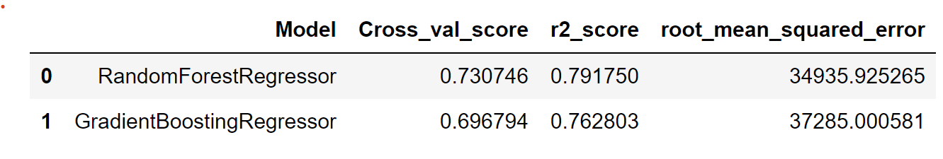
Evaluation best Regressor
As from the accuracy table we can see that Random Forest Regressor is the best Regressor for predicting the price for houses.

Slide 11
Thank You

